Slide 1


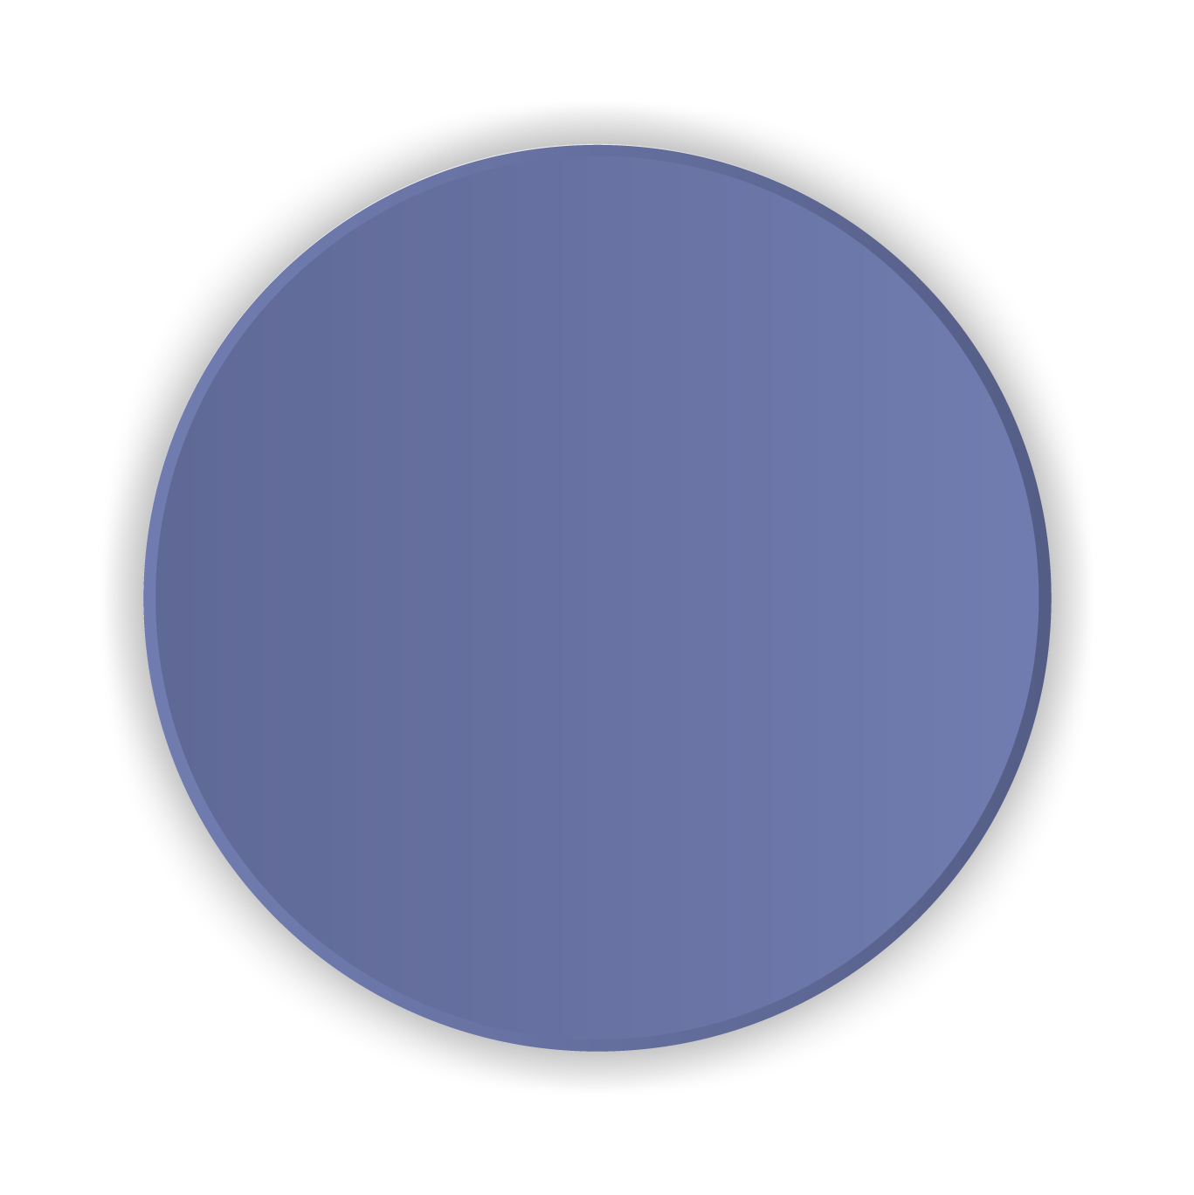



Football Analytics: Harnessing big data to identify players with similar technical attributes
Presented by Kelvin Lim Wan

Slide 2
Contents
1
Introduction
4
Results
2
Related Works
5
Final Framework
3
Methods
6
Conclusion

Slide 3
1
Introduction

Slide 4
Motivation
What is the problem?
Why is the problem important?
Why is the problem challenging?
Upon the departure or ageing of a player, clubs need to identify a player that has a similar technical profile to the departed player if they aim to maintain their current style of play. Further, clubs might be interested in an alternative player who is technically similar to an unobtainable target player.
With big data, clubs should be able to analyse a plethora of players all over the world in just a few clicks, while also eliminating cognitive bias. Besides, in order for less-wealthy clubs to compete with the rich in the transfer window, they need an accurate view on all potential players.
Since football is low-scoring, time-varying and free-flowing, data points collected during matches are not as informative as in other sports. In addition, player similarity is highly subjective, which means that collecting scores from experts as labels would not only be expensive, but also biased.

Slide 5
Research Questions
Which algorithm is the most accurate and intuitive in outputting similar players and similarity scores given a query player?
How can a similarity algorithm be automated for dynamic samples of traits and differing frameworks?

Slide 6
2
Related Works

Slide 7
Research Overview
Benoit Pimpaud (2019) || Player similarities & interpolation || Towards Data Science
Compares Euclidean and cosine distances for football player similarity
Karl Jackson (2016) || Measuring the similarity between players in Australian Football || Conference: Mathematics and Computers in Sport
Introduces a novel measure of similarity between players in the AFL where players are represented by high-dimensional vectors
Analytics FC (2021) || Find Similar || Analytics FC website
Presents an industry-proven framework to identify similar players in European football leagues.

Slide 8
3
Methods

Slide 9
Methodology
EDA
Data Preprocessing
Final Framework
Experiments
Evaluation Metrics
Understand the data and preliminary visualisations
Prepare the data for experiments
Implement multiple algorithms to the data
Quantify the performance of each algorithm

Slide 10
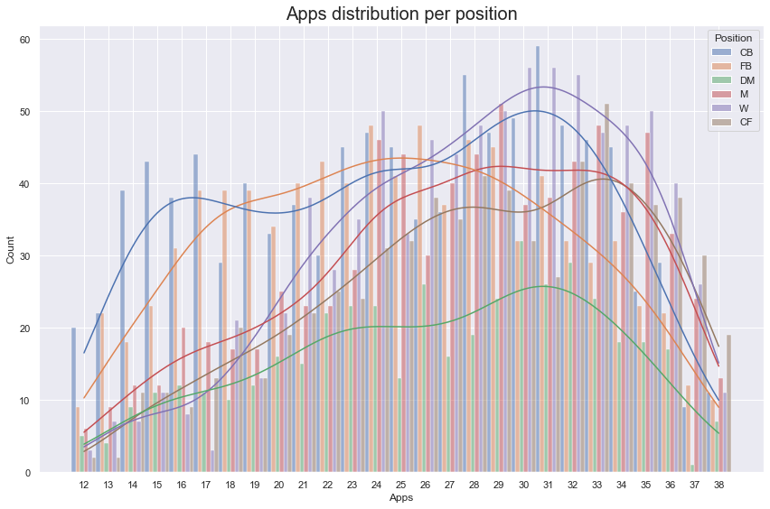
Exploratory Data Analysis - Appearances
Minimum apps: 12
Maximum apps: 38
Negative skew – more players have a higher number of appearances

Slide 11
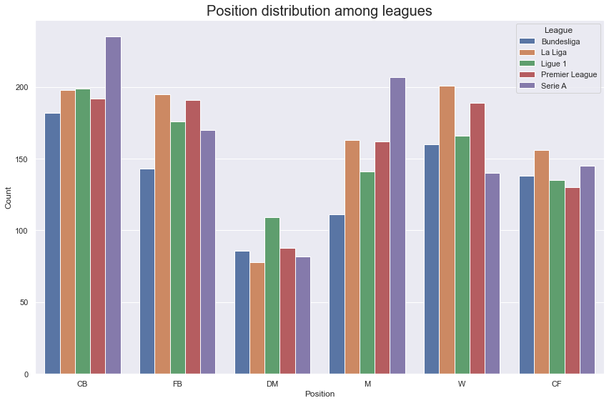
Exploratory Data Analysis - Positions
Most players are Centre-Backs
Least players are Defensive-Midfielders
Uniform distribution of all leagues for each position

Slide 12
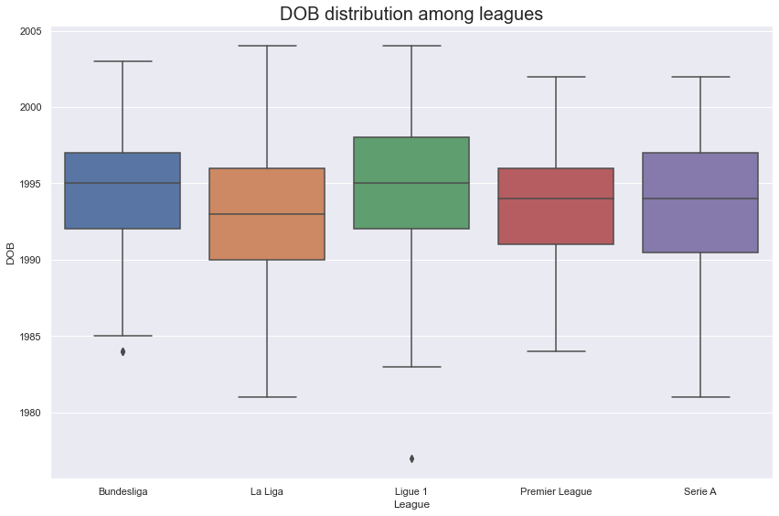
Exploratory Data Analysis – Date of Births
Most players born between 1990 and 1998
Ligue 1 has the youngest crop of players
La Liga has the oldest crop of players

Slide 13
Data Preprocessing
Seasons
2019
2020
2021
2019-2021
2020-2021
2021
Traits for prior individual seasons are not representative of current players’ technical profile
Periods
50% of 2021
33% of 2020
17% of 2019
66% of 2021
33% of 2020
100% of 2021

Slide 14
Experiments
Similarity Measures
Clustering
Self-supervised Learning
Reinforcement Learning
Euclidean Similarity
Manhattan Similarity
Cosine Similarity
Adjusted Cosine Similarity
Pearson Correlation
K-means
Gaussian Mixture Model
Cosine similarity scores as labels:
Fully-connected Neural Network
Skip-connections Neural Network

Slide 15
Evaluation Metrics
Average rank of queried players
The lower the better
Standard deviation of traits ratios for top 20
The lower the better
Scores sparsity
The higher the better
Range of scores
Needs to be intuitive
Skewness of scores
A small negative value is ideal
Kurtosis of scores
A small positive value is ideal
Dynamicity
Needs to be ‘Yes’

Slide 16
4
Results

Slide 17
Evaluation
Method | Average rank of queried player | Standard deviation of traits ratios for top 20 | Scores sparsity | Range of scores | Skewness of scores | Kurtosis of scores | Dynamicity
Euclidean Similarity | 1.00 | 0.371 | 0.101 | [0.06, 10.0] | 29.1 | 921 | Yes
Manhattan Similarity | 1.00 | 0.399 | 0.0978 | [0.02, 10.0] | 32.2 | 1058 | Yes
Cosine Similarity | 1.00 | 0.360 | 0.00135 | [0.28, 1.00] | -1.35 | 5.57 | Yes
Adjusted Cosine Similarity | 1.00 | 0.376 | 0.132 | [-0.96, 1.00] | 0.0931 | -0.704 | Yes
Pearson Correlation | 1.00 | 0.376 | 0.132 | [-0.96, 1.00] | 0.0931 | -0.704 | Yes
Self-Supervised Learning 1 - FC | 47.4 | 0.446 | 0.00120 | [0.42, 0.99] | -1.67 | 7.84 | No
Self-Supervised Learning 1 - SC | 174 | 0.529 | 0.000797 | [0.54, 0.99] | -2.06 | 11.7 | No
Self-Supervised Learning 2 - FC | 1.04 | 0.373 | 0.000830 | [0.43, 1.00] | -1.19 | 6.33 | No
Self-Supervised Learning 2 - SC | 541 | 0.786 | 0.00 | [1.00, 1.00] | 0.00 | -3.00 | No
Gaussian Mixture Model | 13.3 | 0.462 | 0.0244 | [0.00, 1.00] | 6.76 | 48.5 | Yes

Slide 18
Discussion
All similarity measures rank first for ‘Average rank of queried player’, with Self-Supervised Learning 2 – FC a close second
Cosine Similarity ranks first for ‘Standard deviation of traits ratios for top 20’
Adjusted Cosine Similarity and Pearson Correlation both rank first for ‘Scores sparsity’, but mainly due to their large ‘Range of scores’
Self-Supervised Learning 2 – FC has the lowest negative skew, with Cosine Similarity a close second
Cosine Similarity has the lowest positive kurtosis, with Self-Supervised Learning 2 – FC a close second
All methods apart from the self-supervised learning methods allow for dynamicity
Despite having low scores sparsities, it is clear that Cosine Similarity and Self-Supervised Learning 2 – FC are the two best candidates overall. However, Self-Supervised Learning 2 – FC does not satisfy the dynamicity criteria, and is only third for traits ratios deviation.

Slide 19
Cosine Similarity
Final Method

Slide 20
5
Final Framework

Slide 21
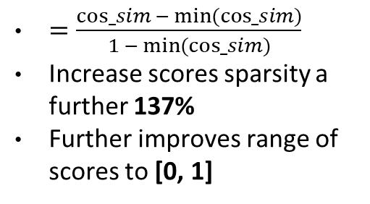
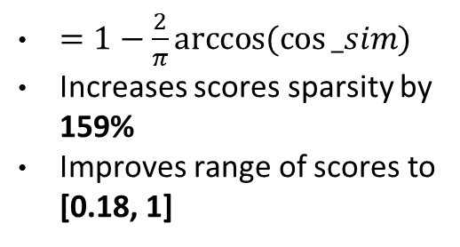
Optimisation
Take the angle
Min-max normalisation
Improve Scores sparsity and Range of scores
$=1−\frac{2}{π}arccos(cos⁡_sim)$
Increases scores sparsity by 159%
Improves range of scores to [0.18, 1]
$=\frac{cos_sim{− min⁡(cos_sim⁡)}}{1{− min⁡(cos_sim⁡)}}$
Increase scores sparsity a further 137%
Further improves range of scores to [0, 1]

Slide 22
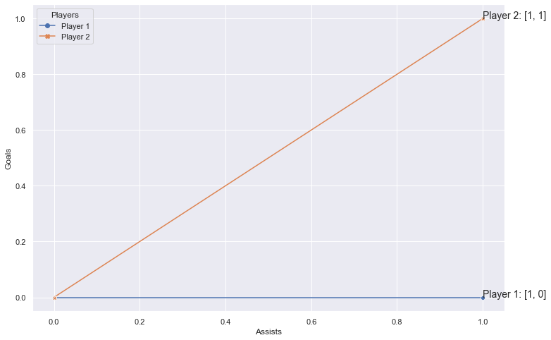
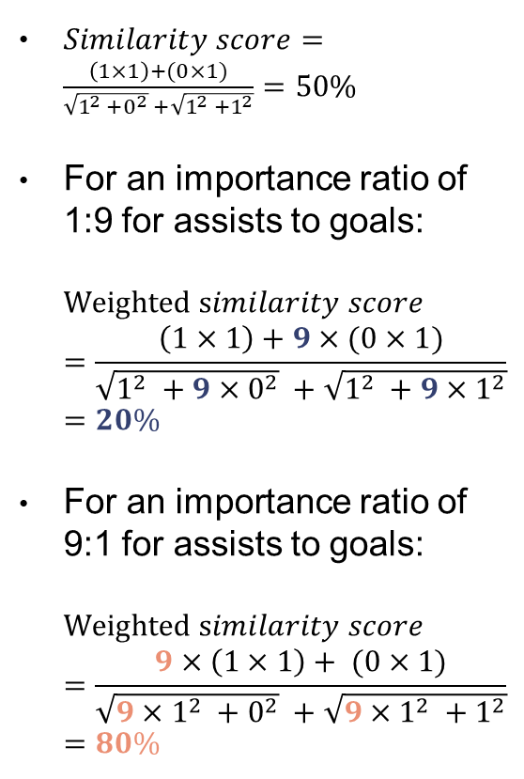
Additional Features – Traits Importance
$Similarity score=\frac{\left(1×1\right)+(0×1)}{\sqrt{1^{2} +0^{2}} +\sqrt{1^{2} +1^{2}}}=50\%$
For an importance ratio of 1:9 for assists to goals: $Weighted similarity score=\frac{\left(1×1\right)+9×(0×1)}{\sqrt{1^{2} +{9×0}^{2}} +\sqrt{1^{2} +{9×1}^{2}}}=20\%$
For an importance ratio of 9:1 for assists to goals: $Weighted similarity score=\frac{9×\left(1×1\right)+ (0×1)}{\sqrt{{9×1}^{2} +0^{2}} +\sqrt{{9×1}^{2} +1^{2}}}=80\%$

Slide 23
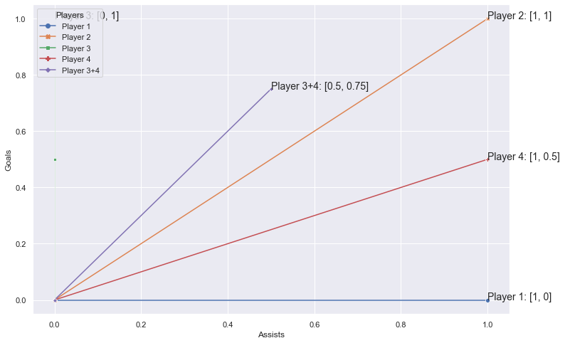
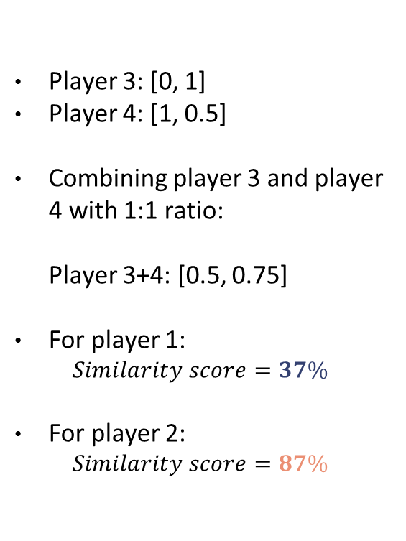
Additional Features – Querying two players
Player 3: [0, 1]
Player 4: [1, 0.5]
Combining player 3 and player 4 with 1:1 ratio: Player 3+4: [0.5, 0.75]
For player 1: $Similarity score=37\%$
For player 2: $Similarity score=87\%$

Slide 24
Additional Features - Filters
Seasons
Leagues
Primary Positions
Age Range
Min. Total Minutes
Min. Overall Rating
One-season or Three-season wonders?
Only want experience in a certain league?
Looking to fill specific primary positions?
Looking for young or old players?
Are the players injury-prone or have weak fitness?
Risk tolerant to potential or want proven players?

Slide 25
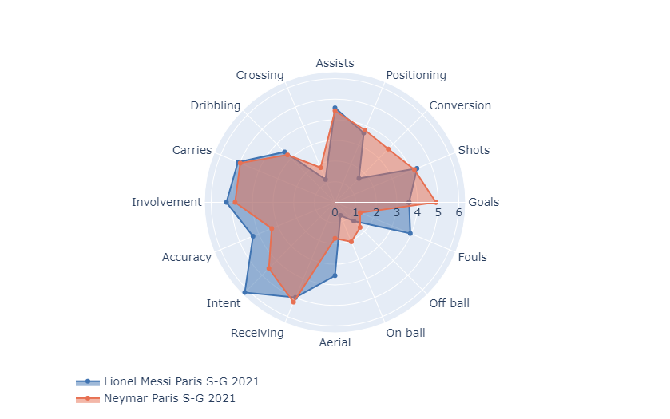
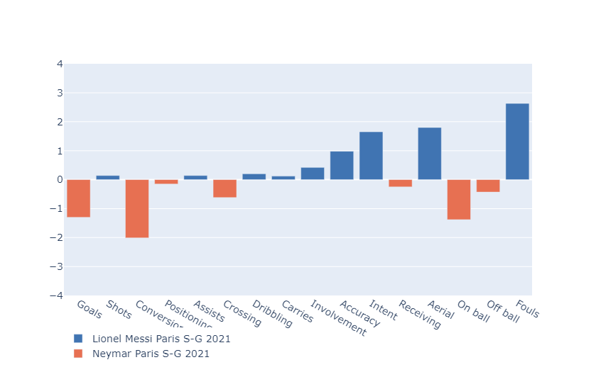
Additional Features – Comparative Visualisation
Radar Charts
Difference Bar Charts
Offeres a visual comparative view of all traits
Offers a comparative view of differences in traits

Slide 26
DEMO

Slide 27
Survey
Surveyee | Random Pair and Score 1 (out of 10) | Random Pair and Score 2 (out of 10) | Random Pair and Score 3 (out of 10) | Random Pair and Score 4 (out of 10) | Random Pair and Score 5 (out of 10) | Random Pair and Score 6 (out of 10) | Random Pair and Score 7 (out of 10) | Random Pair and Score 8 (out of 10) | Random Pair and Score 9 (out of 10) | Random Pair and Score 10 (out of 10) | Average Score (out of 10)
S1 | 8 | 7 | 4 | 9 | 8 | 8 | 7 | 6 | 6 | 7 | 7
S2 | 6 | 9 | 8 | 5 | 6 | 5 | 8 | 10 | 7 | 9 | 7.3
S3 | 7 | 8 | 7 | 9 | 8 | 7 | 8 | 9 | 9 | 6 | 7.8
S4 | 3 | 6 | 8 | 5 | 8 | 6 | 9 | 6 | 7 | 9 | 6.7
S5 | 5 | 7 | 8 | 4 | 4 | 5 | 8 | 6 | 7 | 5 | 5.9
S6 | 10 | 10 | 9 | 7 | 8 | 6 | 7 | 4 | 5 | 4 | 7
S7 | 6 | 8 | 5 | 9 | 10 | 8 | 5 | 7 | 6 | 9 | 7.3
S8 | 8 | 10 | 9 | 6 | 3 | 10 | 7 | 4 | 6 | 5 | 6.8
S9 | 8 | 7 | 7 | 7 | 6 | 8 | 7 | 6 | 9 | 7 | 7.2
S10 | 5 | 9 | 6 | 5 | 7 | 8 | 9 | 8 | 7 | 8 | 7.2

Slide 28
7.02
Overall Survey Score

Slide 29
6
Conclusion

Slide 30
Overview
Benchmarked and provided a comparative analysis of various methods to address the problem of football player similarity scores
Cosine similarity display the best results
With optimisation and additional features, the final framework presents a simple and intuitive pipeline to identify similar players
Overall survey results of 7.02 is satisfiable

Slide 31
Future Work
Add features such as preferred foot and team bias to the model
Tweak and automate the weights in the cosine similarity algorithm to account for the traits importance for each position
With the knowledge of how traits values are derived, we could expand the model to identify similar players in other positions as well
Use in conjunction with age curve to display the performance of similar players by age

Slide 32

Thanks
kelvinlimwan@gmail.com
+61 410 223 214
LinkedIn: Kelvin Lim Wan

